Slide 1
Requirements Modeling
Week 9
G. Larman. An Introduction to OO Analysis and Design and the Unified Process (RE: DOMAIN MODEL, chapters 4-12)
Software Requirements Analysis

Slide 2
Agenda
Brief Review of the Previous Lectures
Domain Model
UML diagrams for the Analysis Model
Organizing Requirements
Documentation
Key Points?
Next?
Software Requirements Analysis

Slide 3
Reminder:
UML Diagrams Appropriate for OO Analysis Modeling:
Use-Case Diagram
(week6,7)
Class Diagram for Domain Model (today)
Interaction Diagrams (today)
Activity Diagram (next)
Statecharts (next)
Domain Model
Use Case Model
(cont.)
Software Requirements Analysis

Slide 4
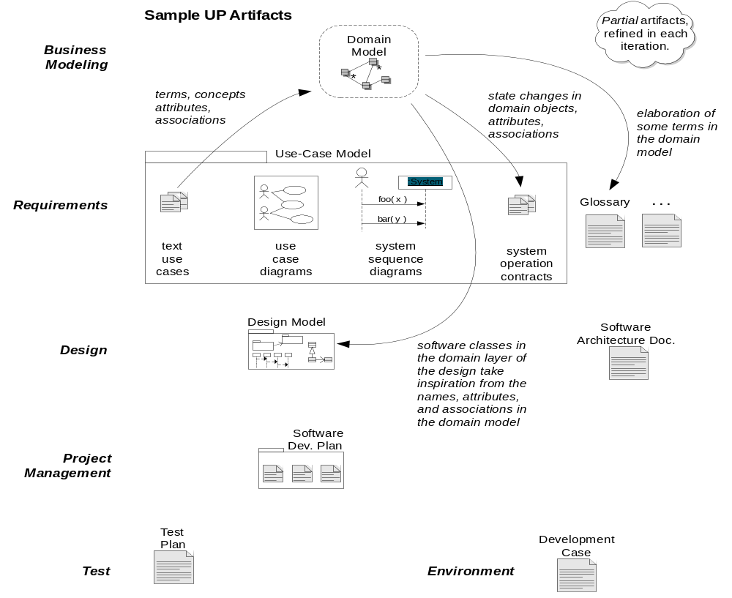
Software Requirements Analysis

Slide 5
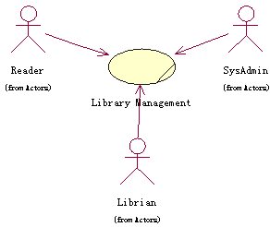
Use Case Diagram Example
Actors
  Reader
  Librarian
  SysAdmin
Use Case
  Library Management
Software Requirements Analysis

Slide 6
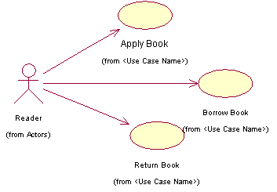
Use Case Diagram of Reader
读者用例图
Software Requirements Analysis

Slide 7
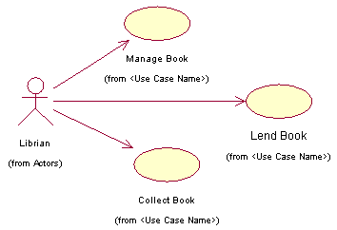
Use Case Diagram of Librarian
图书馆员用例图
Software Requirements Analysis

Slide 8
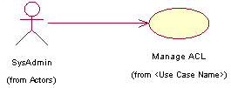
Use Case Diagram of SysAdmin
管理员用例图
Software Requirements Analysis

Slide 9
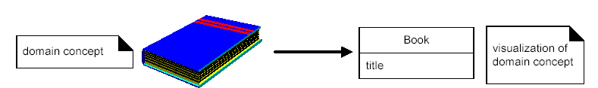
Domain Model
Domain model may be considered a visual dictionary of the noteworthy abstractions, domain vocabulary and information content of the domain.
Software Requirements Analysis

Slide 10
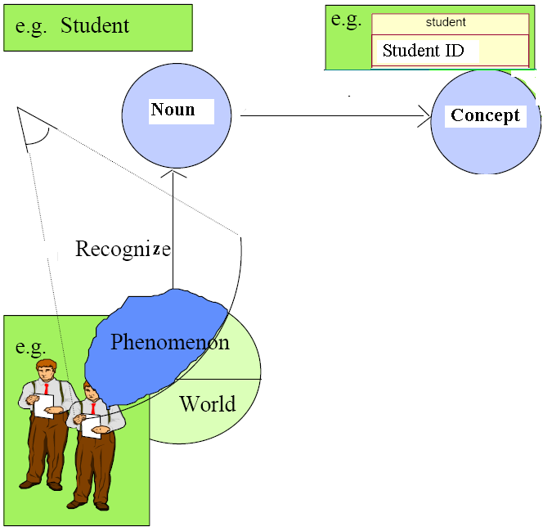
Approach
Software Requirements Analysis

Slide 11
Domain Modeling Guidelines
List the candidate conceptual classes
Draw them in a domain model
Add the associations necessary to record relationships for which there is a need
Add the attributes necessary to fulfill the information requirements
Software Requirements Analysis

Slide 12
Identifying Conceptual Classes
(Larman’s list)
Larman recommends:
  Using a conceptual class category list.
  Identify noun phrases.
See Larman, Section 10.2.
Software Requirements Analysis
Notes:
Ref.: Fowler’s Analysis Patterns (on reserve).

Slide 13
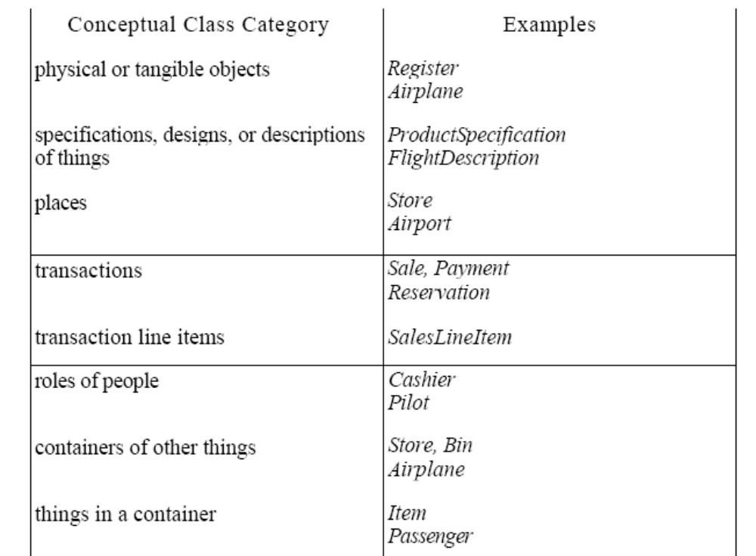
Identifying Conceptual Classes
(Larman’s list)
Software Requirements Analysis
Notes:
Ref.: Fowler’s Analysis Patterns (on reserve).

Slide 14
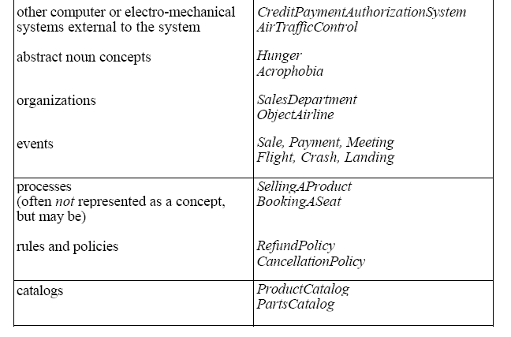
Identifying Conceptual Classes
(Larman’s list)
Software Requirements Analysis
Notes:
Ref.: Fowler’s Analysis Patterns (on reserve).

Slide 15
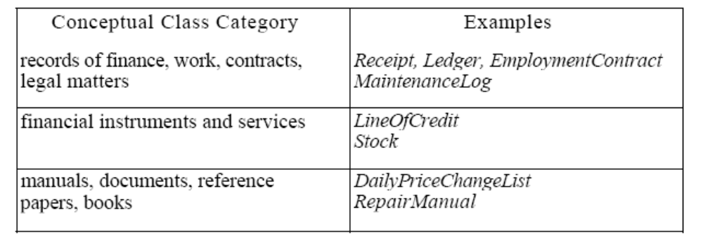
Identifying Conceptual Classes
(Larman’s list)
Software Requirements Analysis
Notes:
Ref.: Fowler’s Analysis Patterns (on reserve).

Slide 16
Example: Dice Game
From Use Case Description to Domain Concepts
Player indicates to the DiceGame system that s/he wishes to start a new game. [Trigger]
System indicates that the player can take a turn.
Player indicates that s/he wishes to take a turn.
System simulates rolling a die and displays the face value.
Steps 3 and 4 are repeated
System calculated the total and displays congratulations message.
Player
Iterative process
Die
FaceValue
DiceGame
total
Software Requirements Analysis

Slide 17

Example: Dice Game
Modeling Domain
Player
name
Die
FaceValue
1
2
Plays
DiceGame
total
1
1
Rolls
Software Requirements Analysis
Notes:
highly-creative activity. It’s hard to measure a good design objectively

Slide 18
Domain Model
… is a representation of
  real-world conceptual classes,
  NOT of software components.
Software Requirements Analysis

Slide 19
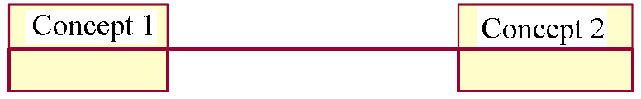

Domain Model: Adding Associations
Associations
  Is a relationship between types that indicates some meaningful and interesting connection
Criteria for meaningful associations:
  Associations for which knowledge of the relationship needs to be served for some duration (“need to know” associations)
  Associations derived from the common associations list.
It is useful to identify those associations of conceptual classes that are needed to satisfy the information
Software Requirements Analysis

Slide 20
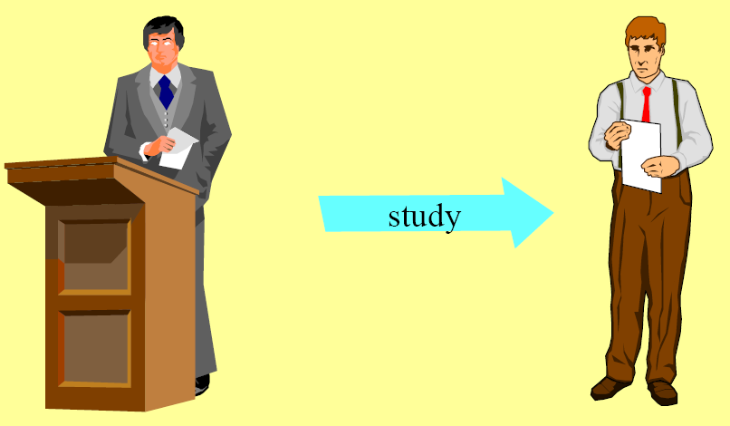
Adding Associations
Software Requirements Analysis

Slide 21
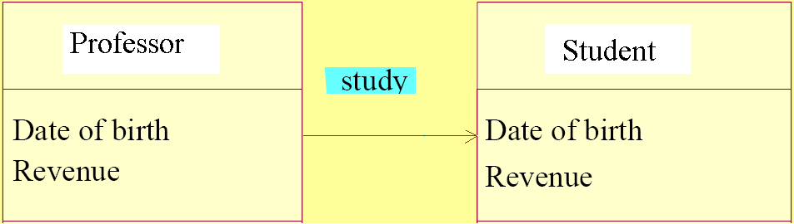
Adding Associations
Software Requirements Analysis

Slide 22
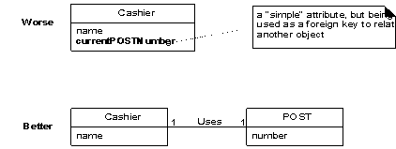
Domain Model: Adding Attributes
In the domain model attributes should be simple attributes or data types
Common types include: boolean, data, number, string, address, color, etc..
Do not use attributes as foreign keys to related to other objects
Relate conceptual classes with an association and not with an attribute
Software Requirements Analysis

Slide 23
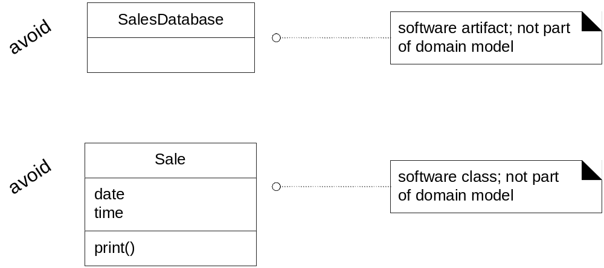
Domain Model – About the Domain, NOT Software
Software Requirements Analysis

Slide 24
Domain Model: Adding Associations
  Each end of an association is called a role which may optionally have:
    Name
    Multiplicity expression
    Navigability
  Naming associations
    Name an association based on a TypeName-verbPhrase format, where the verb phase creates a sequence that is readable and meaningful in the model context.(e.g., paid-by, assigned_to, captures, etc..)
Software Requirements Analysis

Slide 25
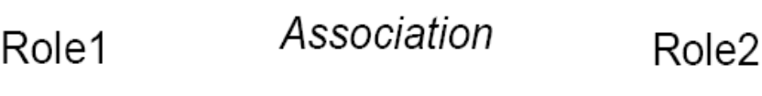
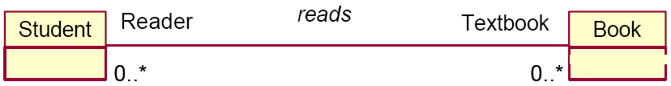
Associations with Roles and Cardinalities
Software Requirements Analysis

Slide 26
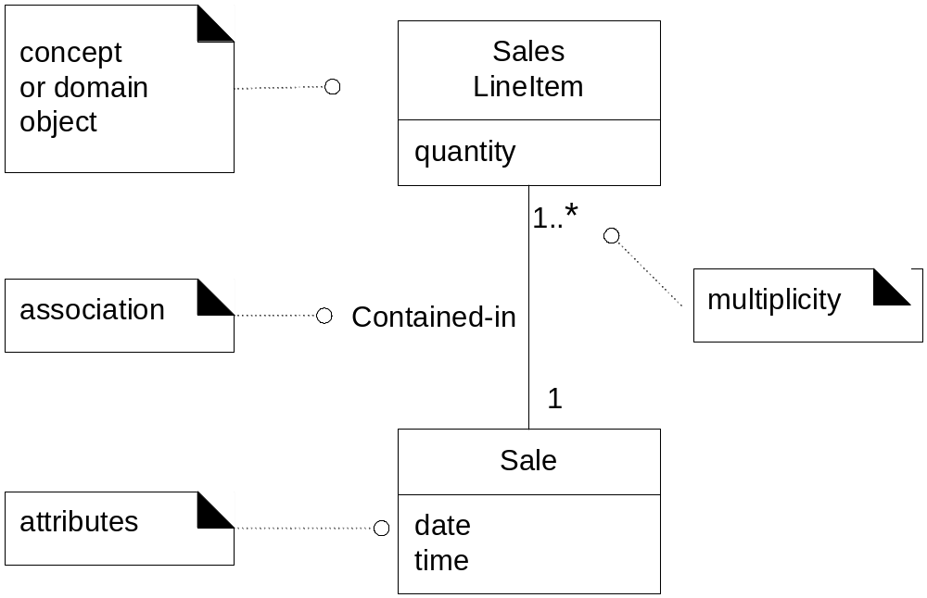
Domain Model – Review
Software Requirements Analysis
Notes:
Larman, p.129.

Slide 27
Specialized Associations
Aggregation
 A special association specifying a “part-of” relations
Composition
 If an aggregation is very strong it is called composition
Software Requirements Analysis

Slide 28
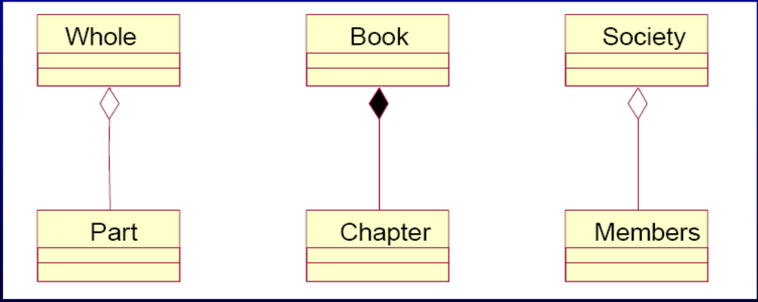
Specialized Associations
Software Requirements Analysis

Slide 29
Specialized Association
聚集（Aggregation）用来表达整体－部分关系的关联。组合（Composition）是一种聚集，是关联更强的形式。
Polygon
Window
1
Polygon
1
1
1
Contains
3..*
points
2
Scrollbar
1
Title
1
Body
Point
Slider
Header
Panel
聚集
组合
Software Requirements Analysis

Slide 30
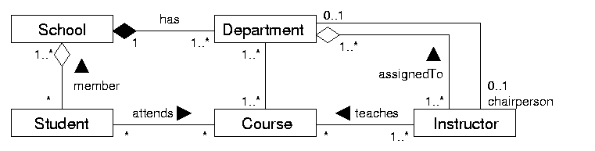
More Complex Example: School
Software Requirements Analysis

Slide 31
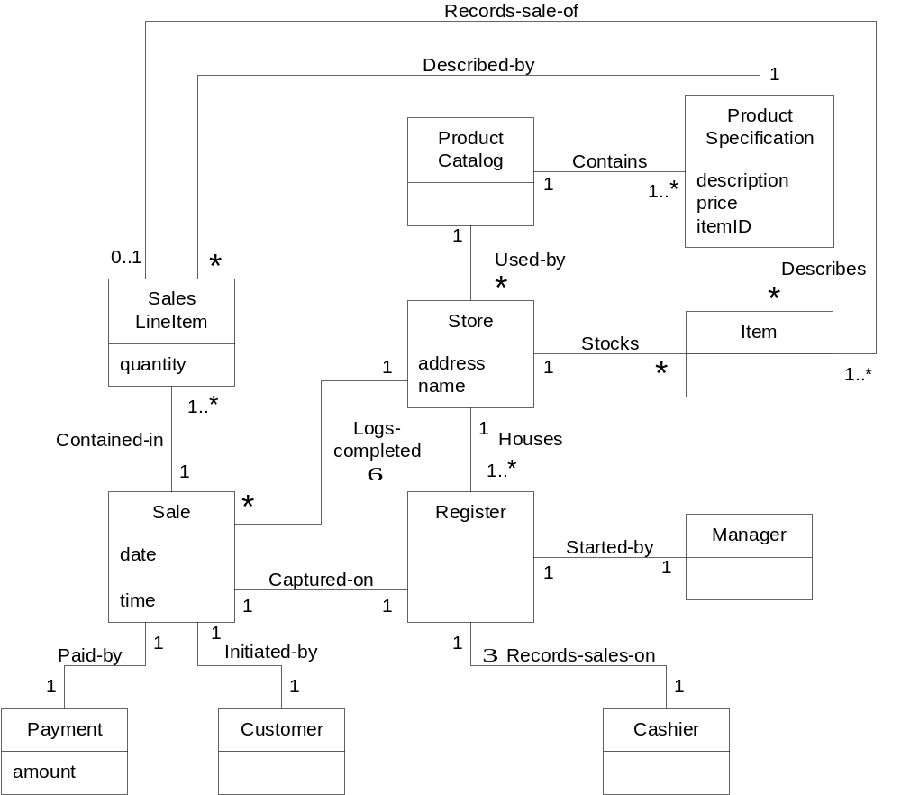
Sample Domain Model
This is a refined
model, developed
over several
iterations.
Software Requirements Analysis

Slide 32
Mapmaker Metaphor (Larman)
Use existing names in the territory.
Exclude irrelevant features.
Do not add things that are not there.
Software Requirements Analysis

Slide 33
UML Diagrams Appropriate for OO Analysis Modeling:
Use-Case Diagram
(week 6，7)
Class Diagram for Domain Model (today)
Interaction Diagrams (today)
Activity Diagram (next)
Statecharts (next)
Domain Model
Use Case Model
Software Requirements Analysis

Slide 34
Interaction Diagrams: Abstraction of Scenarios
UML has a language for describing scenarios, that of the interaction diagrams.
  System Sequence Diagrams (BLACK-BOX)
  Sequence Diagrams (WHITE-BOX)
  Collaboration Diagrams (WHITE-BOX)
Example: Play DiceGame use case
Software Requirements Analysis

Slide 35
Scenario 1: Correct!
A tourist enters into the “Happy Travel” system his destination and the time period he wants to travel to this destination.
The System informs the tourist about the price of the requested trip.
The tourist accepts this price and requests the booking of the trip.
The System confirms the booking and issues a letter of acknowledgement.
Software Requirements Analysis

Slide 36
Interaction diagrams:
System Sequence Diagrams
System Sequence Diagram
  A diagram that illustrates a particular scenario of a use case, the events that external actor generates, answers from the system, and their order.
  The System is considered as a black-box.
  System sequence diagram should be done for the main success scenario of the use case, and frequent or complex alternative scenarios
Software Requirements Analysis
Notes:
p.123, fig.9.5 + p.125 (Role of SSD)+ p.151

Slide 37
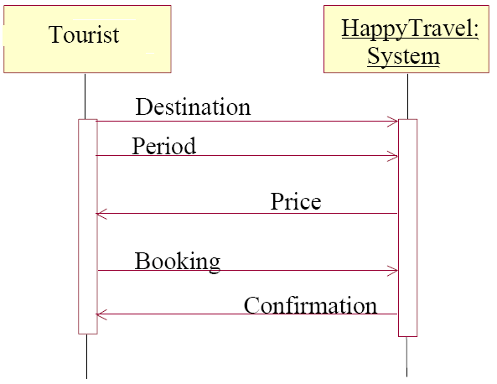
Scenario 1:
System Sequence Diagram
Software Requirements Analysis

Slide 38
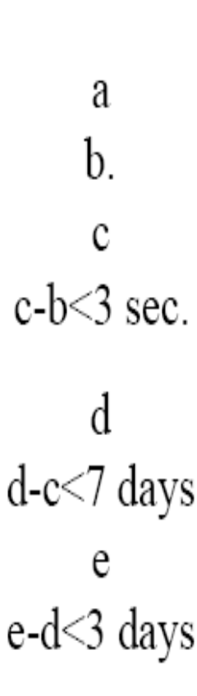
Scenario 1:
System Sequence Diagram with Timing Requirements
Software Requirements Analysis

Slide 39
Interaction diagrams:
(System) Sequence Diagrams
 A sequence diagram has two dimensions:
  vertical placement represents time
  horizontal placement represents different objects (concepts).
Software Requirements Analysis
Notes:
p.123, fig.9.5 + p.125 (Role of SSD)+ p.151

Slide 40
Scenario 2
(Scenario 1 + more details)
A tourist enters into the “Happy Travel” system his destination and the time period he wants to travel to this destination.
The System informs the tourist about the price of the requested trip within 3 seconds.
The tourist accepts this price and requests the booking from the booking department within 7 days.
The booking department creates a document containing the itinerary of the trip and sends a confirmation to the tourist within 3 days.
Extension:
3.a The price is more or equal to 100
3.a.1 The tourist does not accept the price and orders from the booking department about the destination he wanted to go to.
Software Requirements Analysis

Slide 41
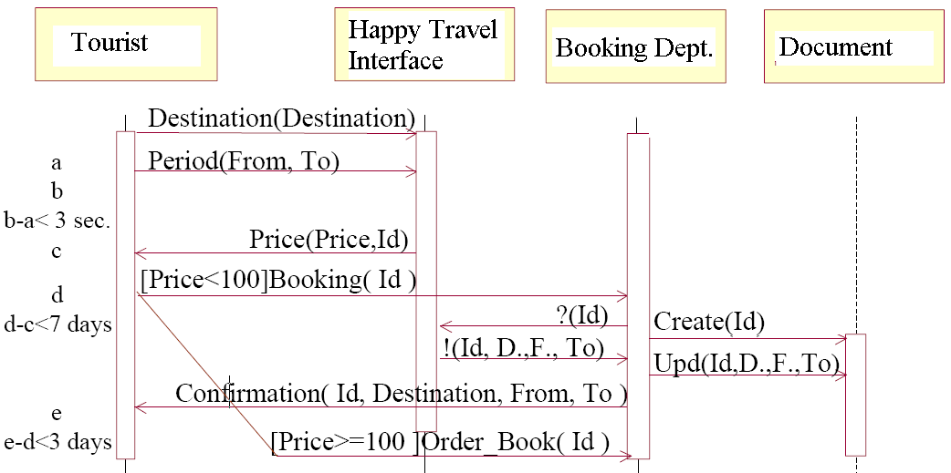
Scenario 2
(Scenario 1 + more details)
Software Requirements Analysis

Slide 42
Example: Dice Game
System Sequence Diagram
Player indicates to the system that s/he wishes to start a new game. [Trigger]
System indicates that the player can take a turn.
Player indicates that s/he wishes to take a turn.
System simulates rolling a die and displays the face value.
Steps 3 and 4 are repeated
System calculated the total and displays congratulations message.
System
Player
Play()
Ready()
Roll()
Face()
Roll()
Face()
Message()
Software Requirements Analysis

Slide 43
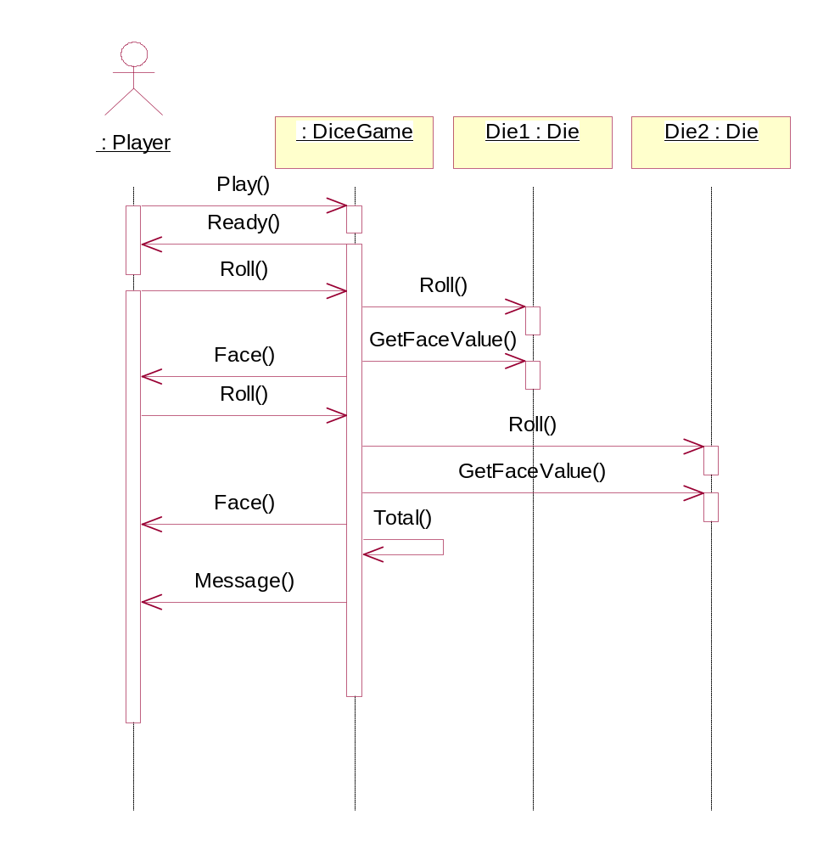
Interaction Diagrams: Sequence Diagram (Dice Game )
Sequence
Diagram
Software Requirements Analysis
Notes:
highly-creative activity. It’s hard to measure a good design objectively

Slide 44
Example: Collaboration Diagram
Die2 :
Die
: Player
1: Play()
3: Roll()
8: Roll()
7: Roll()
9: GetFaceValue()
2: Ready()
6: Face()
10: Face()
12: Message()
11: Total()
Die1 :
: DiceGame
Die
4: Roll()
5: GetFaceValue()
Software Requirements Analysis

Slide 45
Interaction Diagrams Notation
Type | Strengths | Weaknesses
Sequence | Clearly shows sequence or time ordering of messages Simple notation | Forced to extend to the right when adding new objects Consumes horizontal space
Collaboration | Space economical, flexibility to add new objects in two dimensions Better to illustrate complex branching, iterations and concurrent behavior | Difficult to see sequence of messages More complex notation
Software Requirements Analysis

Slide 46
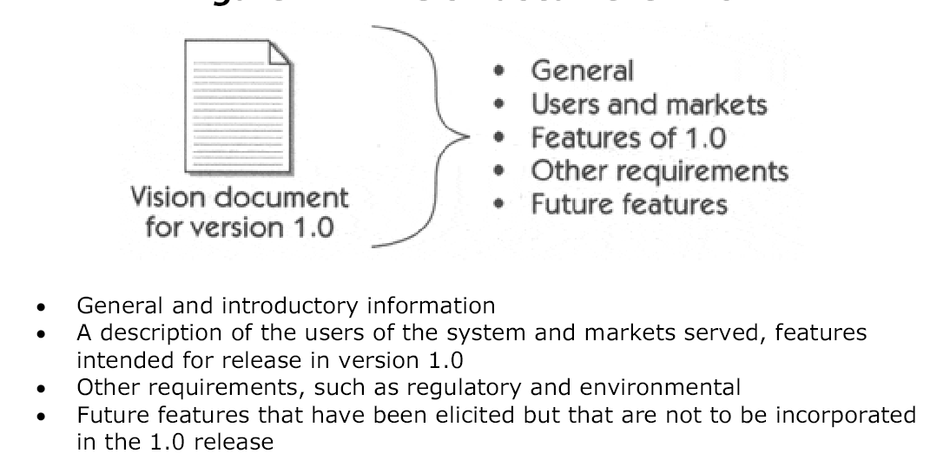
Vision Document
Software Requirements Analysis
Notes:
This document serves as the foundation for our 1.0 release and drives the more
detailed software requirements and use cases that will more fully elaborate the
system.

Slide 47
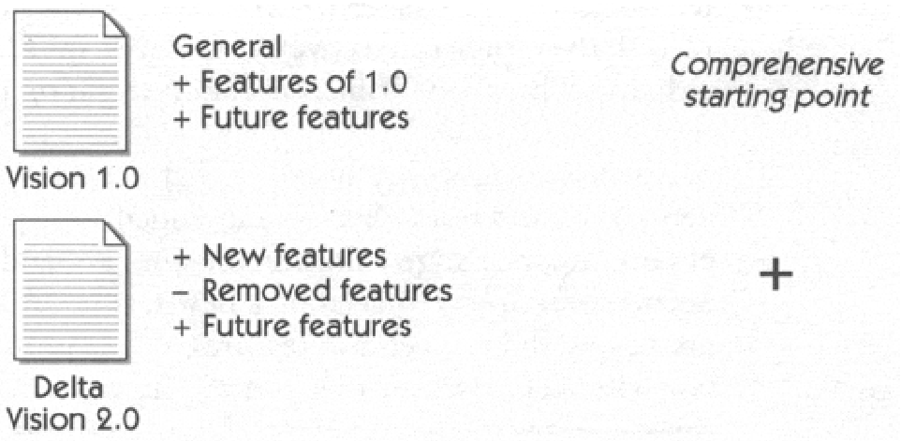
Delta Vision Document
Software Requirements Analysis
Notes:
focuses primarily on what is new
and what is different about this release. This focus on only that which has
changed is a primary learning technique and is extremely beneficial in dealing
with complex systems of information.

Slide 48
Supplementary Specification: content
Functional requirements not expressed in use cases
Non-functional requirements
  Quality attributes of the system
  Legal, regulatory and documentation requirements
Design constraints
Software Requirements Analysis

Slide 49
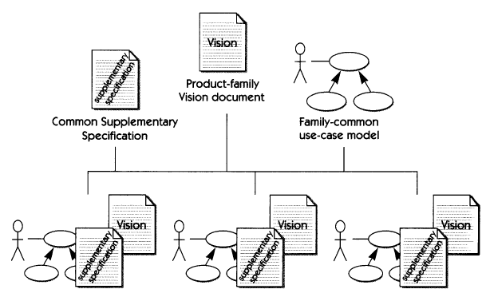
Requirements Organization for Nested Systems
Software Requirements Analysis

Slide 50
Product Road Map
(check with Dekker)
Factor the Vision Document into a Product Road Map
  Graphical ties of software delivery milestones
Input:
  Product features, relative priorities, key dates in the customer’s calendar
  Resource estimates (provided by the engineering team).
    Size estimation (methods: COSMIC-FFP, etc.), Productivity estimation (from the historical data for a given organization), Effort estimation (in person-months), Cost estimation ($ per person-month, depends on the organization; outsourcing?)
Output (next slide)
Software Requirements Analysis

Slide 51
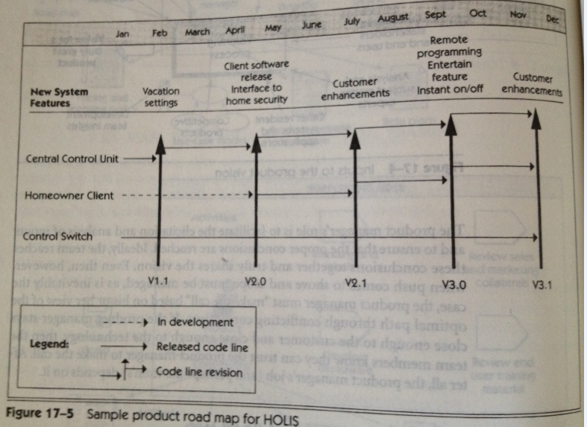
Product Road Map (Fig 17-5)
Software Requirements Analysis

Slide 52
Key Points?
Software Requirements Analysis

Slide 53
TRACEABILITY:
the ability to find corresponding or related information in other documents or software
Use Cases
Desired functionality
Design
Model
Expressed in terms of
realized by
Tested in
Structured by
implemented by
Domain
Model
Analysis Model
SRD
Design
Model
AD, DD
Implementation
Model
code
Test
Plan
Software Requirements Analysis

Slide 54
NEXT ?
Technical Methods for Specifying Requirements
Software Requirements Analysis

